Slide 1

AI Powered Personal Tutor
Transforming Education with Smart Technology

Slide 2

Overview
VLearn is an AI-powered personal tutor that leverages advanced machine learning techniques to deliver tailored learning experiences. The name “VLearn" stands for "Virtual Learning" and also reflects the concept of "We Learn" collaboratively. Our project, VLearn, adapts courses to each learner's capabilities by generating customized multiple-choice questions (MCQs) using our fine-tuned T5 model.

Slide 3
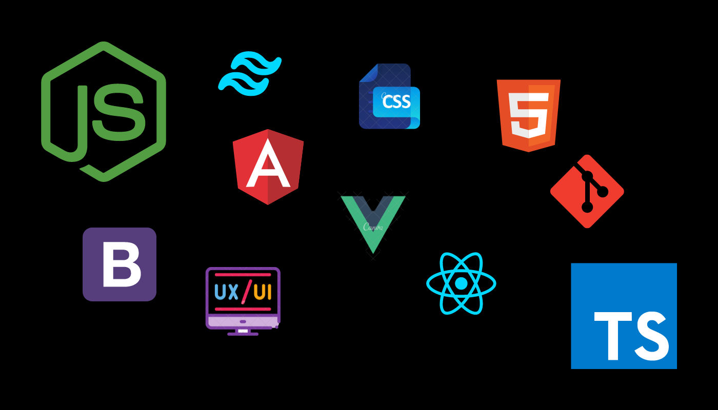
01
Frontend Dev

Slide 4

Technologies Used
Frontend Development Overview
React.js is used for building the user interface (UI).
Enables creation of interactive and dynamic UI components.
Supports smooth navigation and real-time updates.
Node.js is used on the backend.
Handles asynchronous operations (e.g., API requests).
Powers the server to serve RESTful APIs efficiently.

Slide 5
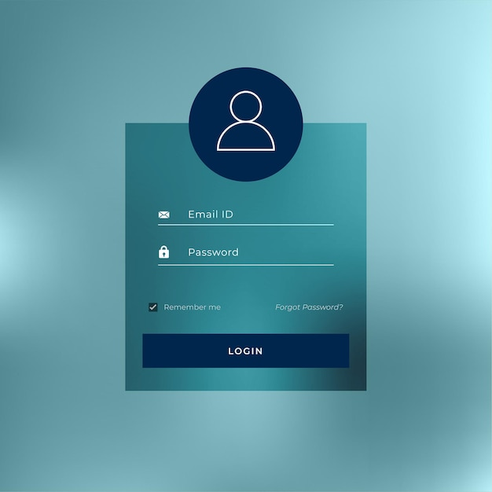
User Interface Design
The UI design is centered on user experience, featuring a clean layout that allows easy navigation through course selections, assessments, and progress tracking. Key React.js components are used to dynamically load content, ensuring an engaging and intuitive experience for users.

Slide 6
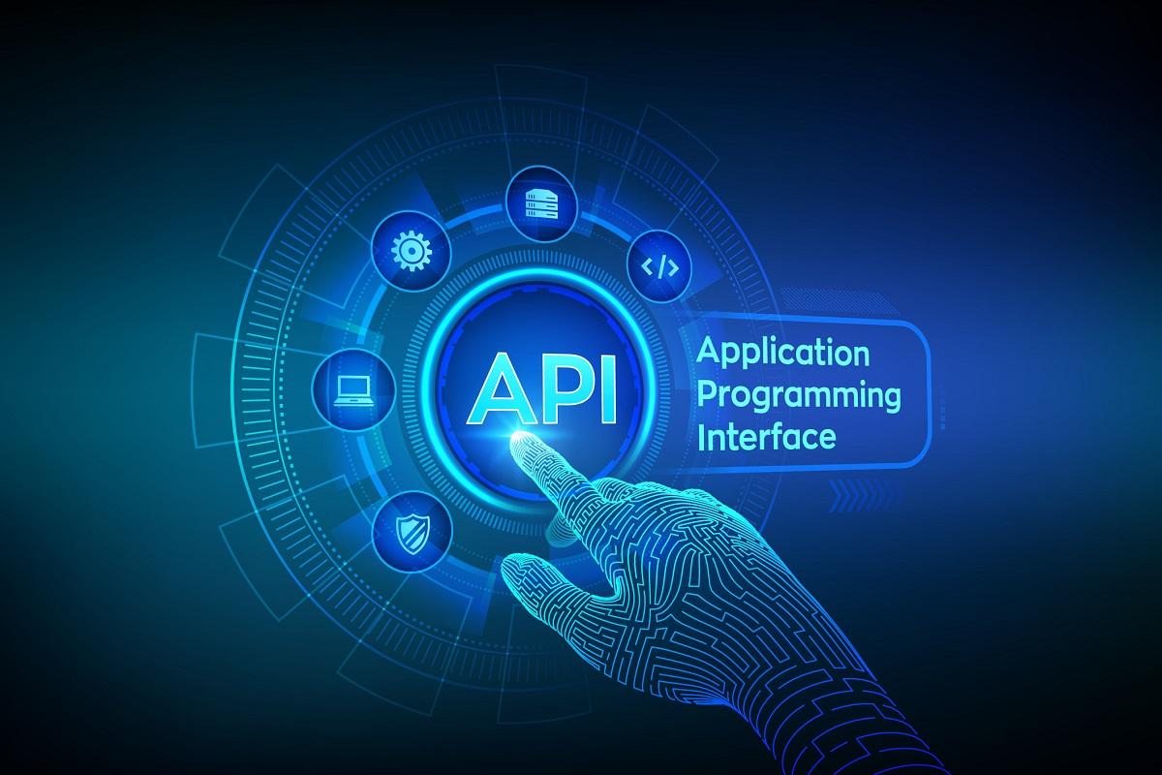
API Communication
The interaction between the frontend and backend is facilitated through RESTful API calls. These APIs handle data fetching for course content, user assessments, and submission of results, enabling seamless communication and data flow between the client and server.

Slide 7

02
Course Generation

Slide 8

Data Collection
Educational content is collected from a variety of reliable open-source materials, including GitHub repositories and MOOCs. This extensive data collection process ensures diverse and comprehensive course offerings.

Slide 9
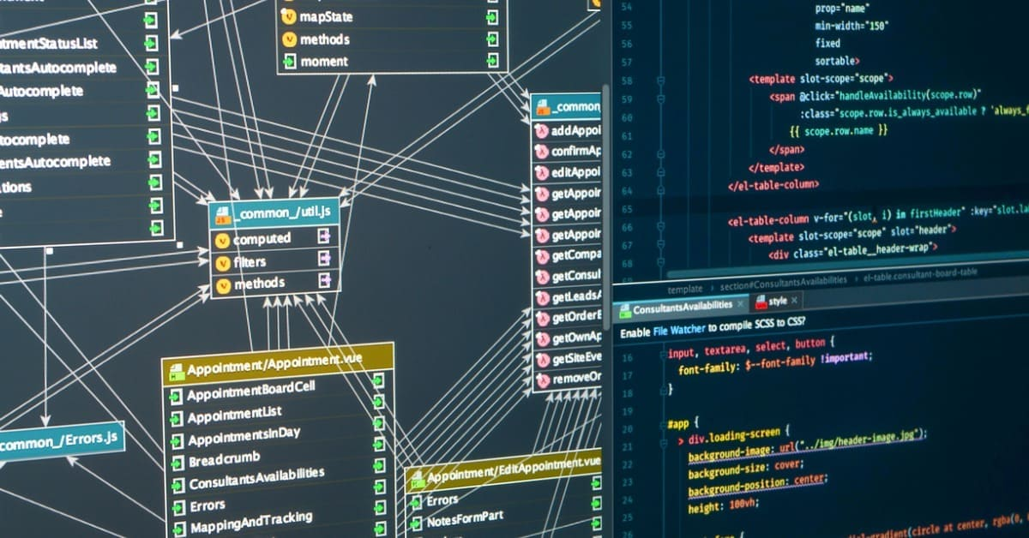
Module Structure
The structured data is organized into six primary modules, each encompassing 5-6 relevant subtopics. This modular design helps to break down complex subjects into manageable sections, making learning more accessible.

Slide 10

Content Formatting
All course content is written in text (.txt) files, which allows for easy formatting and readability. The structured content is stored in MongoDB, facilitating efficient data management and retrieval.

Slide 11

03
MCQ Dataset

Slide 12

Question Generation
Multiple-choice questions (MCQs) are generated both manually and programmatically. The process involves analyzing course content to create a diverse range of questions that assess learners' understanding.

Slide 13

Difficulty Levels
MCQs are categorized into three difficulty levels: Basic, Intermediate, and Advanced. This categorization ensures that assessments are tailored to various learner capabilities, enhancing the educational experience.

Slide 14

JSON Formatting
All generated MCQs are saved in a structured JSON format, which allows for efficient storage, retrieval, and manipulation of data. This format ensures seamless integration when fine-tuning machine learning models and serves as a foundational structure for handling various content types.

Slide 15

04
Model Training

Slide 16

T5 Model Setup
The T5 model, which stands for Text-to-Text Transfer Transformer, is initialized using the 'transformers' library from Hugging Face. This powerful model is adept at various NLP tasks and has been pre-trained to understand and generate text efficiently.

Slide 17

Dataset Preprocessing
Before training, the MCQ dataset is preprocessed to match the input-output format required by the T5 model. This involves transforming text passages into a form where questions are generated based on key points extracted from the content.

Slide 18

Training Process
The dataset is subsequently split into training and validation sets to evaluate the model's performance. The T5 model is trained in a GPU-based environment to accelerate the training process, utilizing techniques such as a learning rate scheduler and early stopping to optimize results.

Slide 19

05
Integration

Slide 20

BackendDeployment
The trained T5 model is deployed as a web service using Flask or FastAPI. This setup allows external applications, such as the frontend of the personal tutor, to access the model's capabilities through defined API calls.

Slide 21
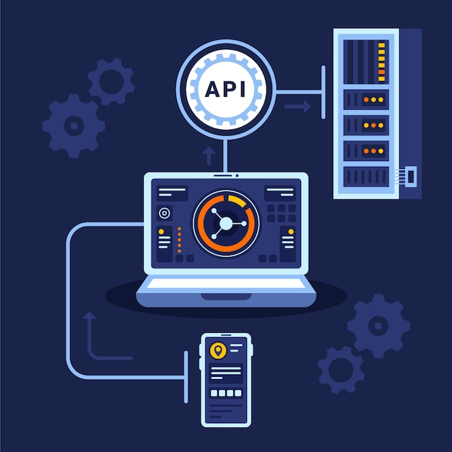
API Endpoints
API endpoints are created to facilitate the generation of MCQs based on user input, such as selected courses or modules. These endpoints handle the communication between the model and the frontend, ensuring dynamic interaction for users.

Slide 22

Database Management
The MongoDB database is utilized to store various data points including course material, user progress, scores, and generated MCQs. MongoDB Atlas is used for cloud-based management, allowing for scalability and ease of data retrieval.

Slide 23

06
Additional Features

Slide 24

Chatbot Support
A chatbot powered by the DeepSeek R1 7B model is integrated into the system, providing students with a conversational interface for asking course-related questions, getting motivational support, and receiving study tips.

Slide 25

AI Assistant
The AI assistant features personalized study plans that adapt based on the learner's performance. It analyzes ongoing assessments and dynamically modifies MCQs to focus on learners' weaker areas.

Slide 26

Adaptive Learning
The system incorporates adaptive learning paths that adjust course difficulty based on individual quiz performances. This feature ensures that each learner receives a tailored educational experience, catering to their unique learning pace.

Slide 27

Conclusions
The AI-powered personal tutor project illustrates the integration of advanced technologies in education. With a focus on user experience and personalized learning, it holds the potential to enhance educational outcomes and empower learners through innovative tools.

